Slide 2
Very Few Challenging Vision Applications are Successfully Deployed Today
Level 3:
High Performance Vision
High throughput
Server Class & Networked Computer Resources
Large # of Cameras
Very High Speed Product Movement
Challenging Lighting & Imaging
Sophisticated Algorithms
Level 2
PC & Embedded CPU
Substantial Computer Resources
Wide Variety of Algorithms
Limited Machine I/O
Small Number of Cameras
Level 1
Smart Cameras
Modest CPU Resources
Simple Algorithms
Minimum Control
Level 0
Bar Code & 2D Scanners

Slide 3
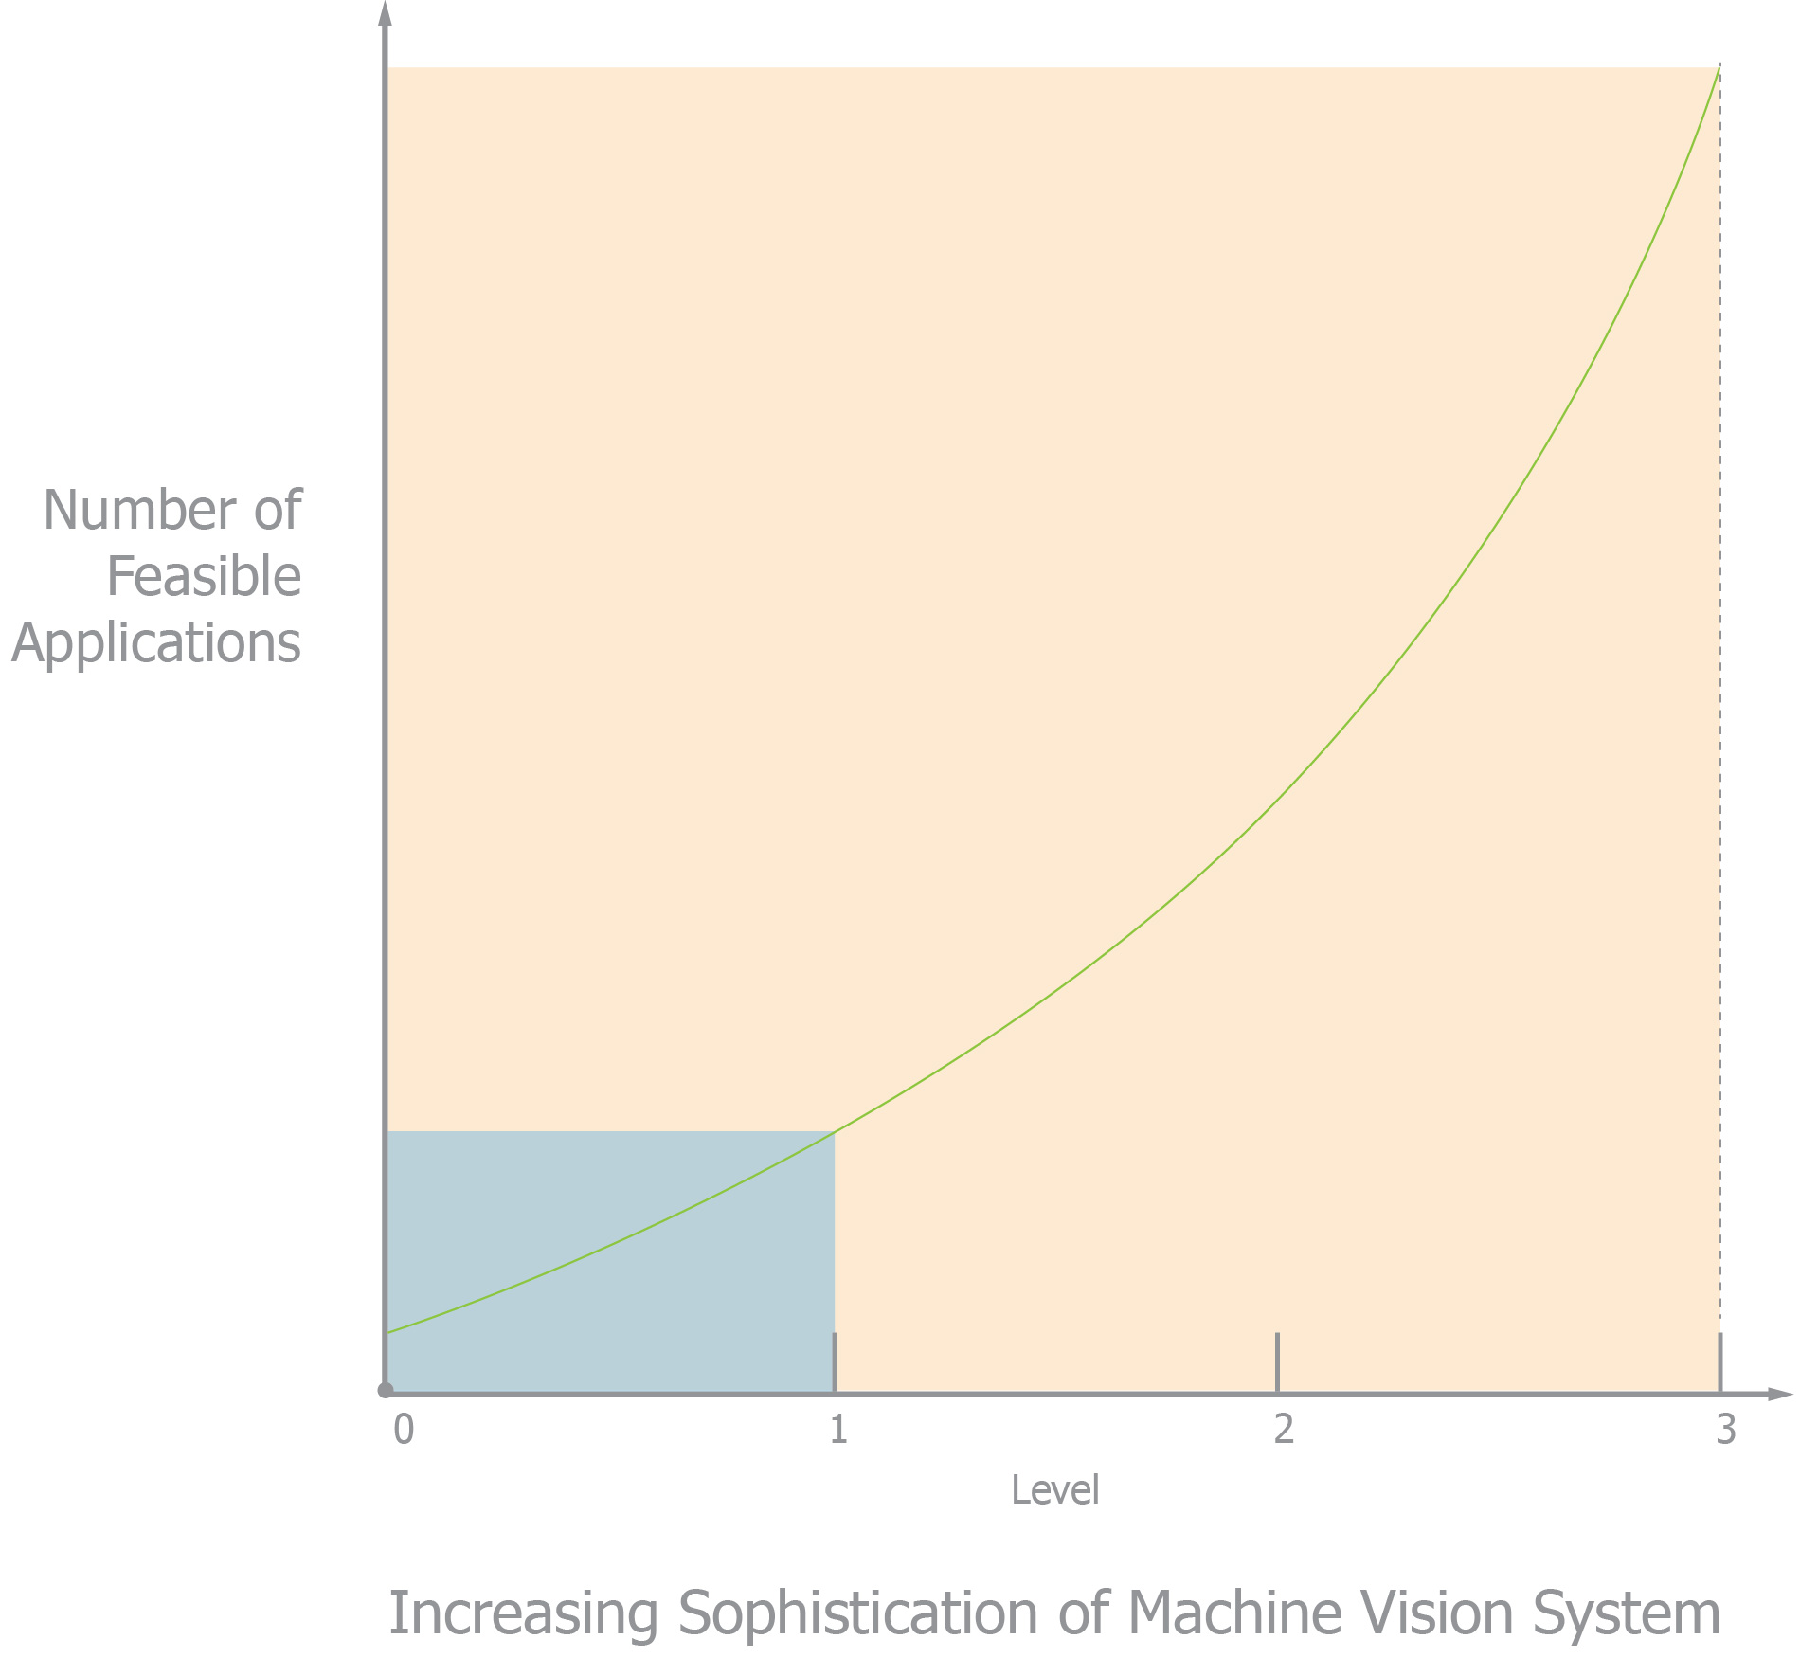
More Capable Machine Vision Systems Address More Applications
Increasing the capability of machine vision system dramatically increases the number and value of viable applications – by an order of magnitude
Robust Vision Systems
> 10 x
Unsophisticated Vision Systems

Slide 4
Machine Vision Applications are Labor Intensive
Until now time & cost for most machine applications has been too high for viability.
Time & Cost to deploy Machine Vision has been exponentially related to required Performance
Most feasible applications until now have been too expensive even for OEMs to develop and field in terms of hardware, software, engineering and production costs

Slide 5
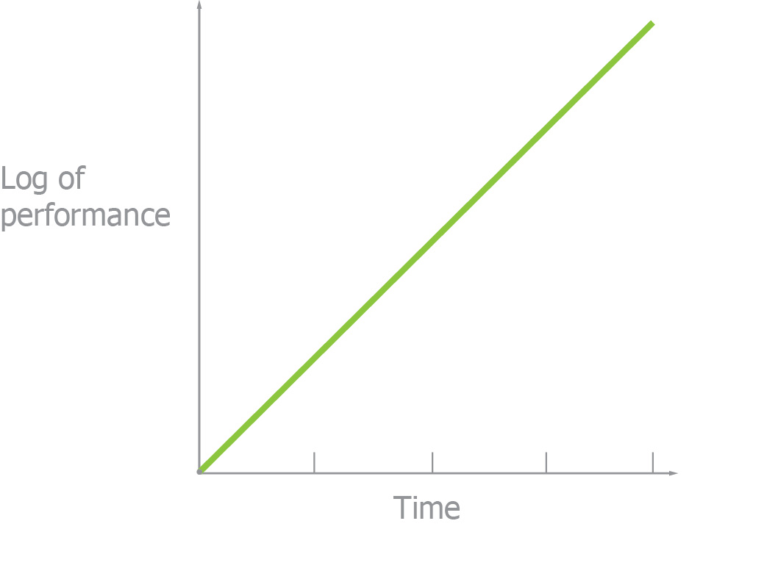
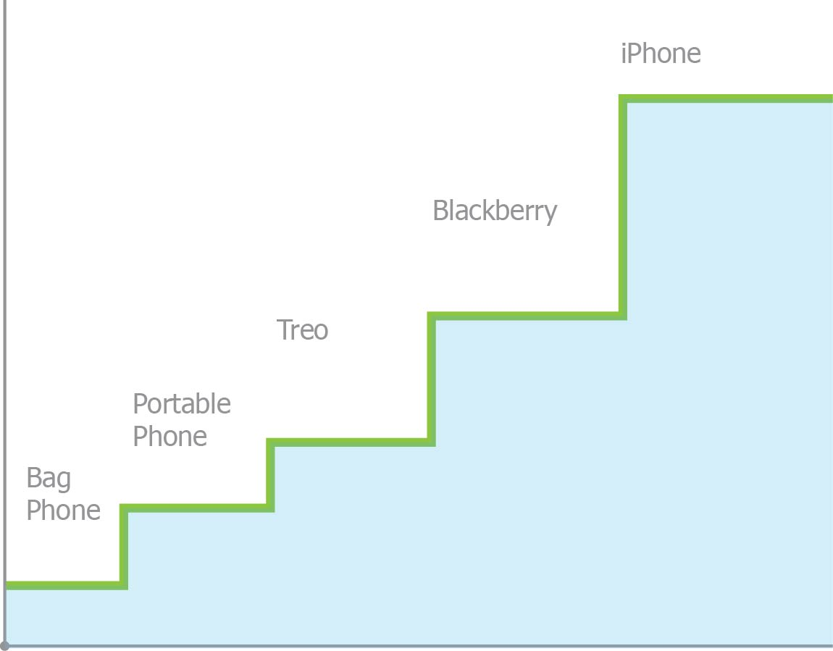
The Machine Vision Market has Progressed Slower than Expected
Industries whose progress requires advancements in multiple independent capabilities change rarely, but suddenly…
Capability and performance increase and costs fall in all industries over time
When steady improvements one key attribute are possible and sufficient to drive the economics of an industry, progress is smooth as shown by the effect of continuous reduction in transistor size for digital electronics.
Industries progress in a stepwise manner when simultaneous advances of multiple enabling technologies are necessary to substantially change their scope and economics. Rapid transformations occur in these markets when changes in multiple enabling technologies are all present creating Critical Thresholds of Elegance.
Progress of cellular phones to smart phones depended on advancements in several orthogonal areas: Batteries, Analog Power Semiconductors, Network Standards, Software, and Capital Investment in Infrastructure.
Semiconductors, Moore’s Law
Critical Thresholds of Elegance

Slide 6
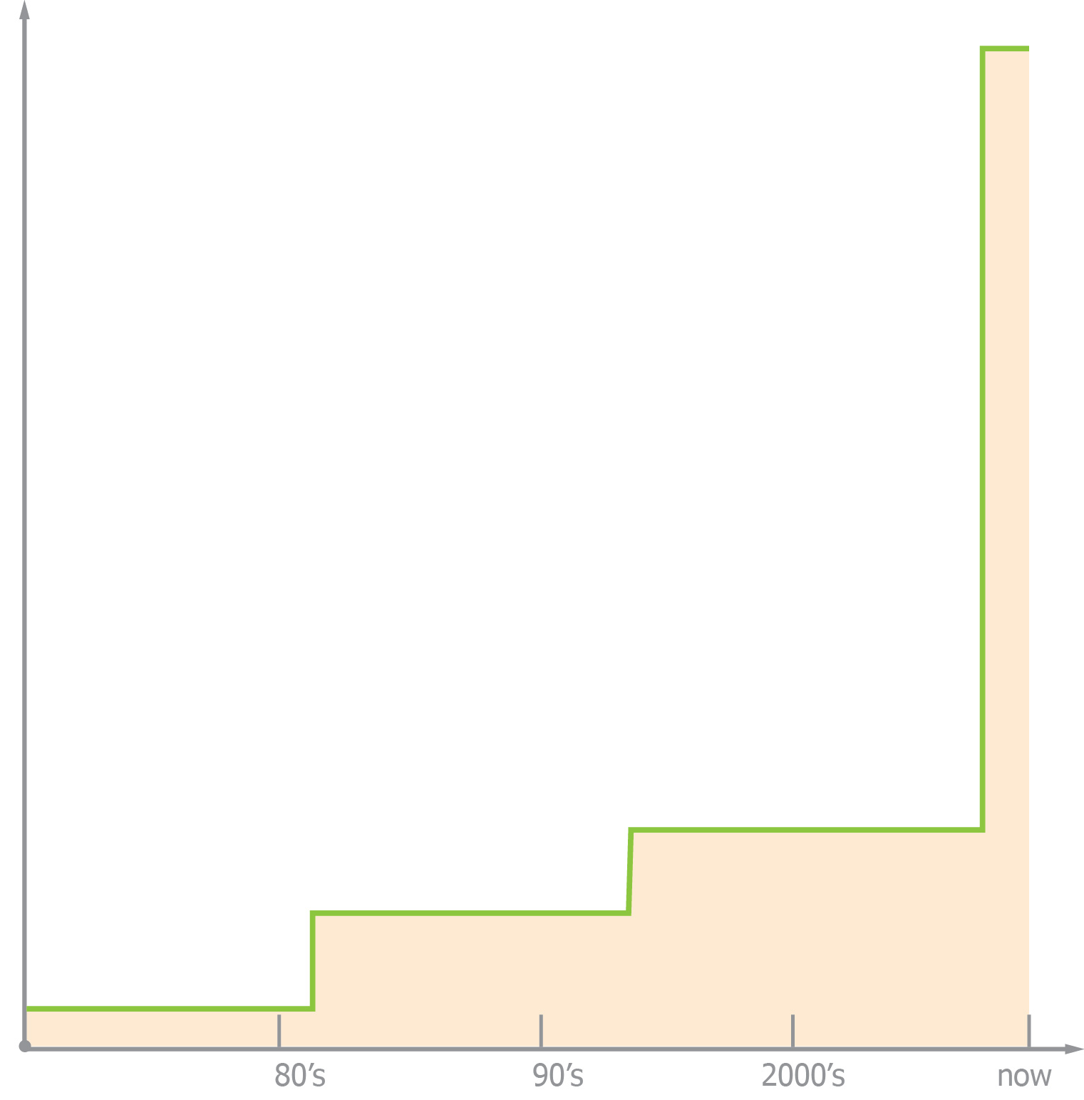
The Machine Vision Market is an Extreme Example
Progress of the Machine Vision Industry has been stalled for a very long time since simultaneous progress was required in several essential enabling technologies.
Networking
Embedded Computers
Rugged, deployable outside electrical-cabinets
Powerful POE in/out
Internal/Ethernet Switches & DMA Engines
Internal EHS PLC
IP67 Packages
Wiring Reduction – One Cable per Device
Power
Images
Trigger
Communication
Strobes
Lighting
LED
Remote
In-Camera
Machine I/O & Control
System Design
Division and Coordination of Real-time and Computational Domains
Image Metadata
True Real-time (1uS) coordination via the network
Natural Algorithm & System Design
Ergonomic development environment with Unlimited Flow Graphs
Event Driven System Design
Vertical Tools
Open Architecture
Diagnosis /Monitoring
Automated Deployment, Monitoring, & Repair
Progress
Decades

Slide 7
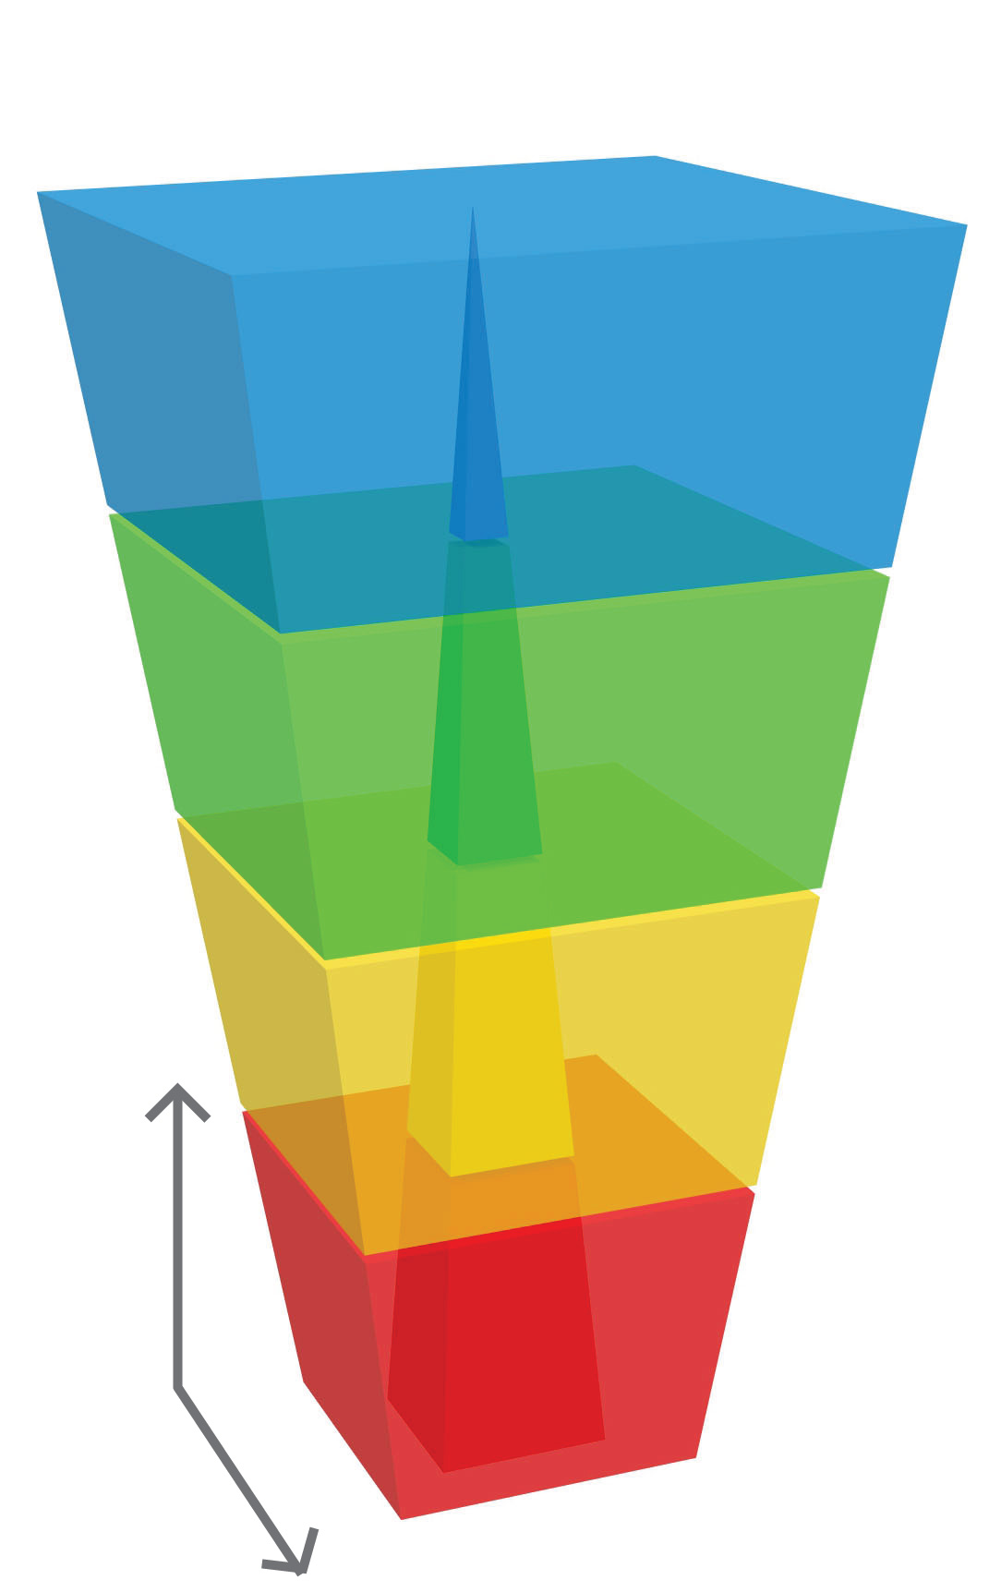
For every application components and methods from Opteon and Visics provide accurate, highly reliable Vision You Can Deploy in a Day®.
Applications accessible with Visics & Opteon components and methods
High Performance Vision
Multi-Camera PC Based Vision
Applications feasible with conventional devices
Smart Cameras
INCREASING PERFORMANCE
Bar Code Readers and 2D Scanners
QUANTITY OF DEPLOYMENTS

