Slide 1
Notes:
Visics and Opteon working together for 25 years to
simplify high-performance machine vision systems and make them more reliable.

Slide 2
Very Few Challenging Vision Apps Successfully Deployed Today, because it takes two years to develop them
Level 3:
High Performance Vision
High throughput
Server Class & Networked Computer Resources
Large # of Cameras
Very High Speed Product Movement
Challenging Lighting & Imaging
Sophisticated Algorithms
Level 2
PC & Embedded CPU
Substantial Computer Resources
Wide Variety of Algorithms
Limited Machine I/O
Small Number of Cameras
Level 1
Smart Cameras
Modest CPU Resources
Simple Algorithms
Minimum Control
Level 0
Bar Code & 2D Scanners

Slide 3
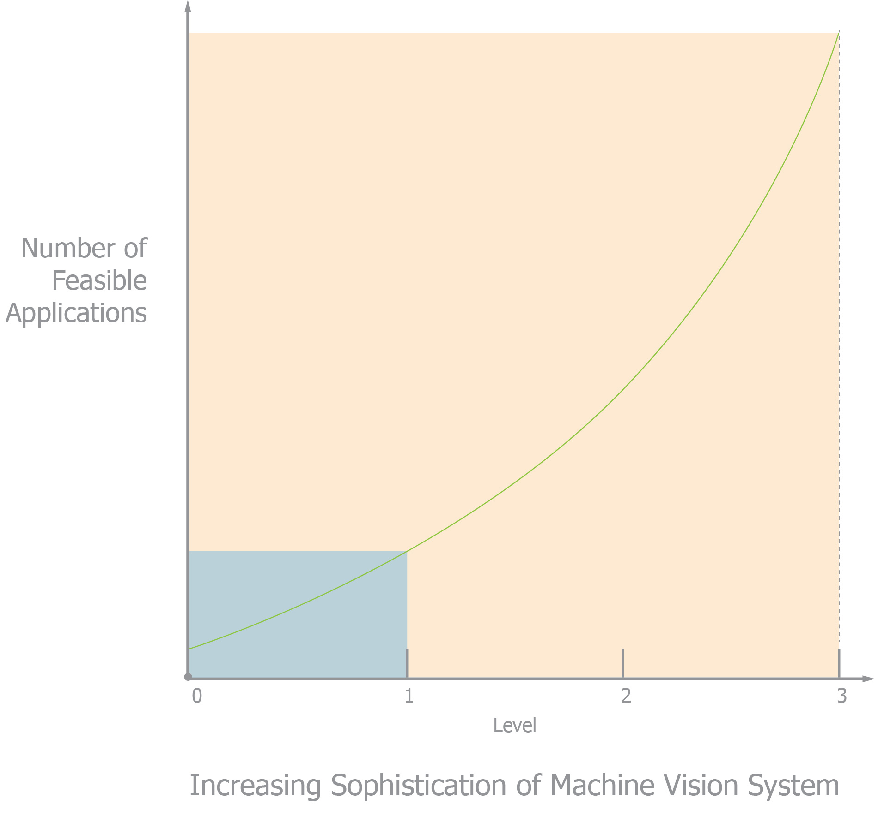
More Capable Machine Vision Systems Address More Applications
Increasing the capability of machine vision system dramatically increases the number and value of viable applications – by an order of magnitude
Robust Vision Systems
> 10 x
Unsophisticated Vision Systems
Notes:
Comments: If Smart Cameras could solve challenging vision applications the vision industry would be far larger than it currently is. While congratulations are in order for how far the MV industry has progressed, some humility is in order as we contemplate that the majority of applications remain un-realized, unshipped. Every glass is half-full.

Slide 4
What’s holding us back?
Development Time
Project Cost
Low System Throughput
Low Reliability
Too many cables
Too many gaps between components to be bridged – both hardware and software
Notes:
Comments: We’ll come back to these issues in greater depth later, but it is useful to set the stage now with these key ideas …

Slide 5
Machine Vision Applications are Labor Intensive
Until now time & cost for most machine applications has been too high for viability.
Time & Cost to deploy Machine Vision has been exponentially related to required Performance
Most feasible applications until now have been too expensive even for OEMs to develop and field in terms of hardware, software, engineering and production costs

Slide 6
Why have Smart Cameras been so successful?
Smart Camera Advantages are a simple consequence of the fact that a single component is the Vision “System.”
Relatively Reliable:
no functional gaps to be bridged and
one cable per device (power, communications, and images)
The one cable is simple and standard, an Ethernet cable
Very quick to deploy
Relatively simple to program
No application-specific customization required
Despite addressing a small fraction of the application space for MV, Smart Cameras have been tremendously successful

Slide 7
Smart Camera Cons
Limited
Speed
Image Fidelity
Algorithms
Compute Power
Long Latencies
Image Analysis
Communications
Little or no lighting control
Single Image View limits methods
Multi-view 3D
Multi-sensor analysis
Multiple-station inspections
Closed Architecture, means not extensible
Multi-vendor sensors
Multi-vendor algorithms
Customer specific enhancements
Not scalable

Slide 8
Challenge
Challenge is to give PC Based Vision all of the advantages of a Smart Camera, while increasing system capabilities even beyond currently available PC Based Vision
Rapid Deployment (Placement and Connectivity)
Rapid Application Development
Open Architecture
Much higher reliability

Slide 9
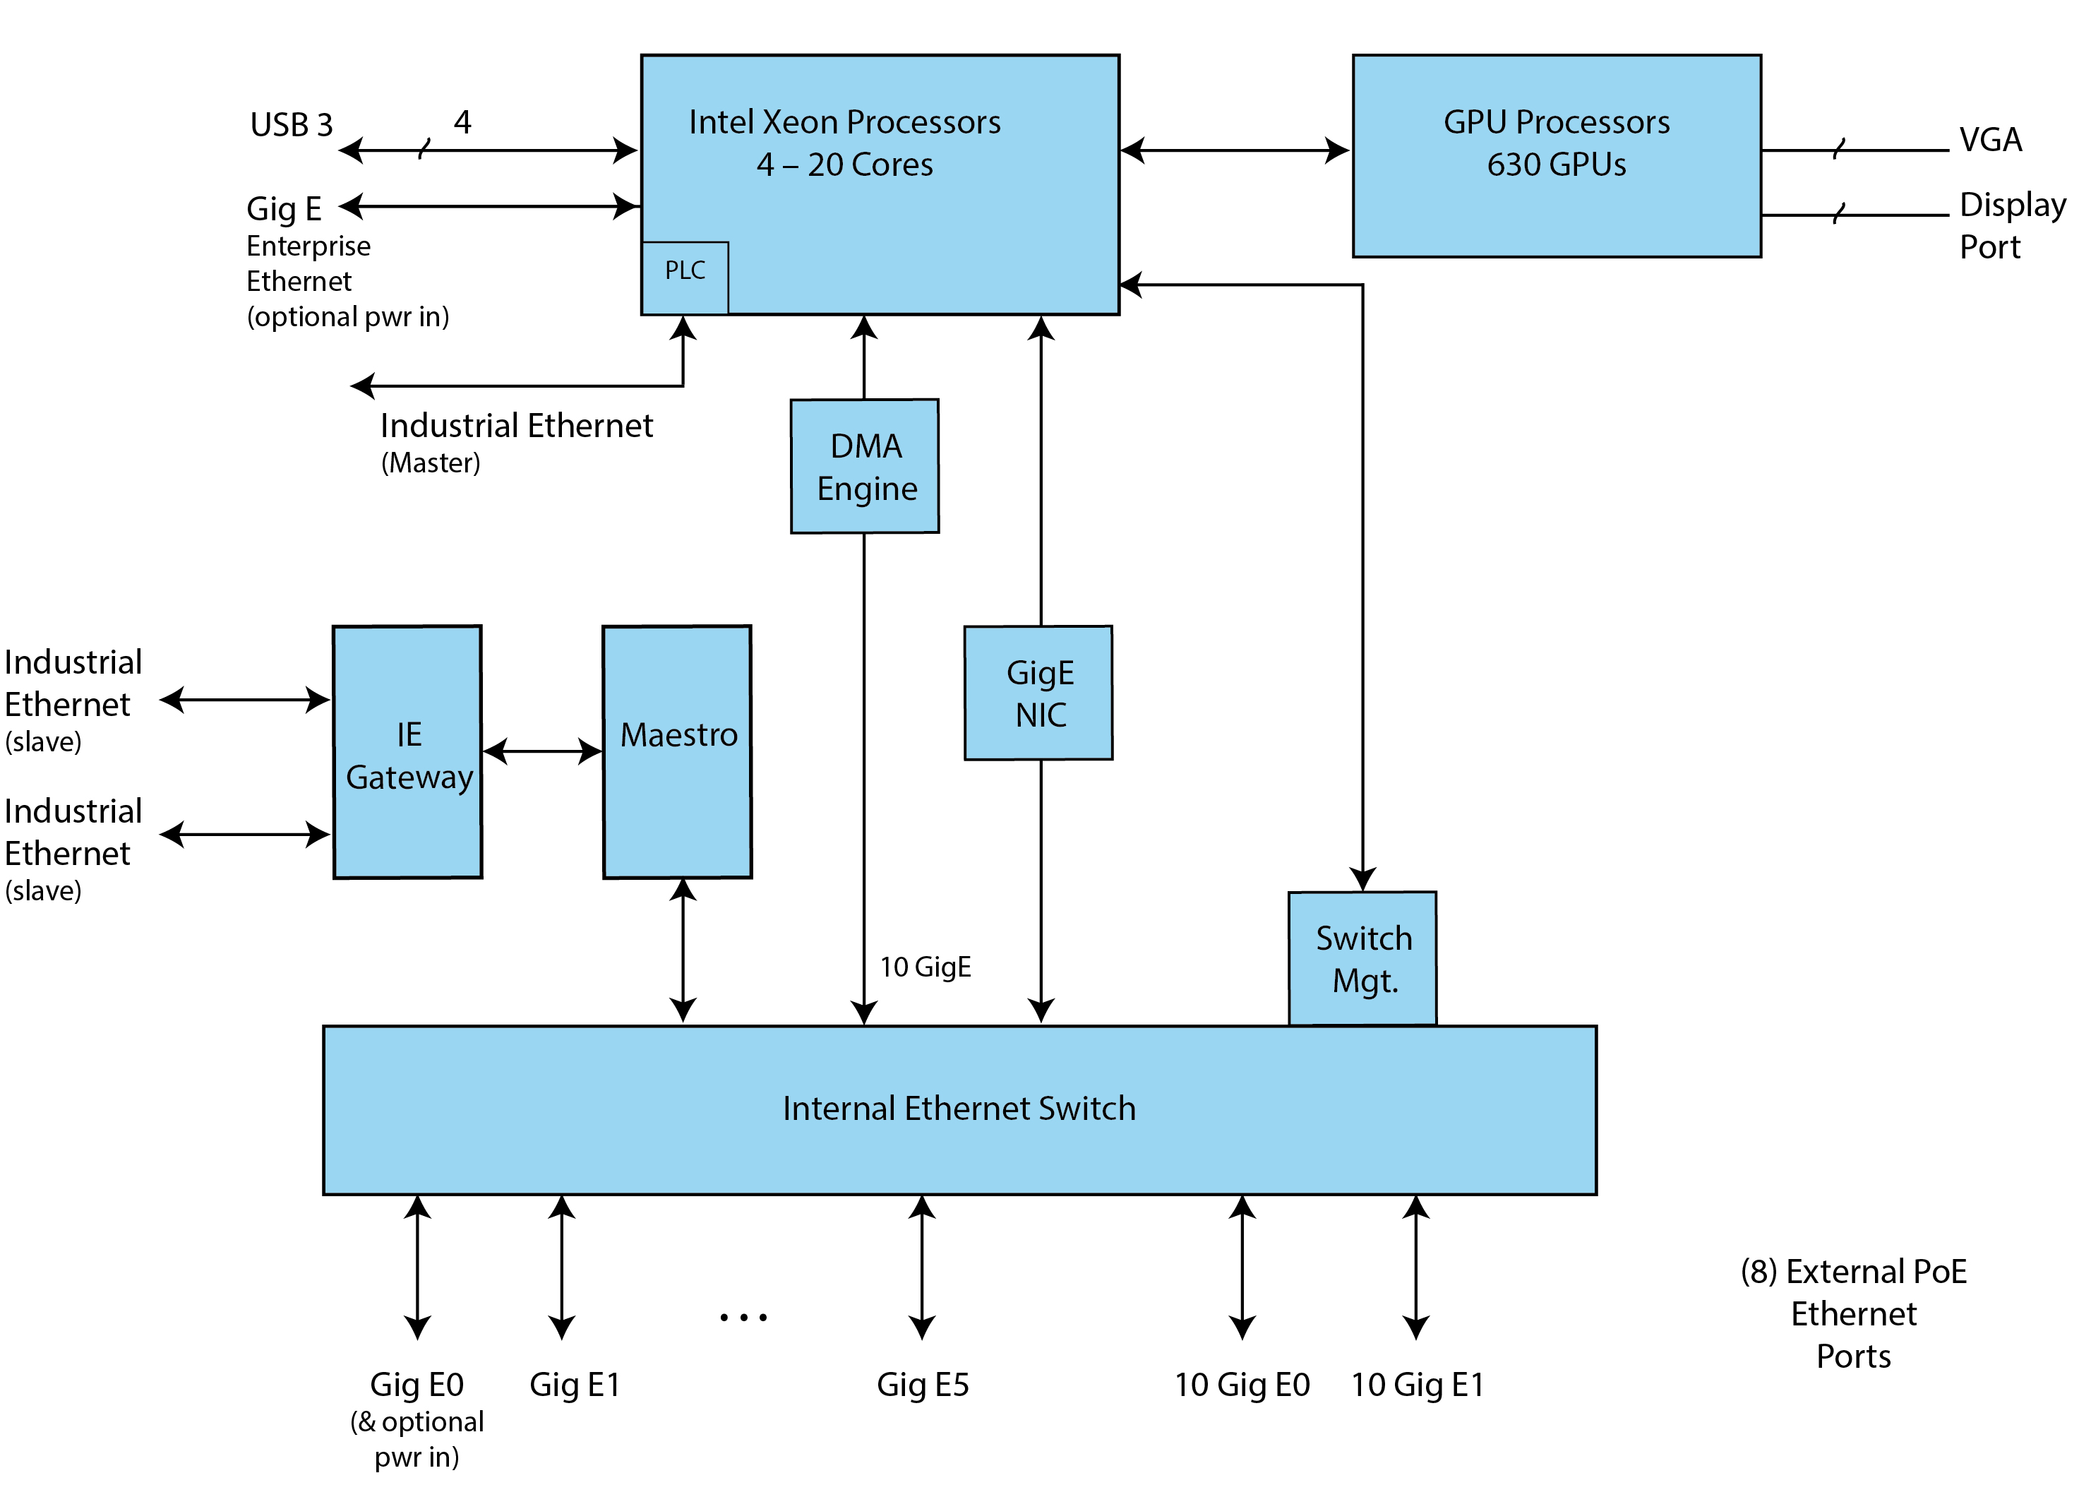
EASY 320, System Block
A critical part of the answer is highly integrated vision for rapid deployment: EASY 320, System Block Diagram

Slide 10
Code-free RAD Environment (Rapid Application Development)
Another is a code-free RAD Environment that can accept any .NET utility, application, or algorithm and make it immediately available as a block in one of any number of flow graphs in your project
Automatic Graphical Mapping and Monitoring of System Connectivity
Graphical Representation of Program Flow
Event Driven Organization
Execution Engine Thread-safe on Symmetrical Multiprocessor Computers
Open Architecture, in this case accepting of procedures developed elsewhere (other vendors, or internally generated capabilities)
Code Free GUI Builder for Operator’s Consoles, etc.

Slide 11
“Good Standards”
But it must be Open Architecture Reliant on “good standards” which are proven, highly reliable, and allow no Vendor Specific Variations in other words, true standards
Ethernet
PoE Ethernet
GeniCam
.NET
Industrial Ethernet
SQL

Slide 12
Reliability
It must also be much more reliable than PC Based Vision; even for fast, complicated, widely distributed machines
Image Metadata for unbreakable data tagging and parts tracking on multi-core, event-driven computers
10x Cable reduction – virtual cables for faster and guaranteed response, together with long-term reliability
Entire system must snap together like Lego blocks using industry standard cables and breakout boxes
Intimate connections to non-imaging sensors, actuators, PLCs, and the Enterprise
No interface circuitry required
Via industry standard I/O cables and Breakout Boxes
1 uS latency network-wide communication and decision making, intimately connected to sensors and PLCs. PLC is hosted in the Vision Platform which is IP67/IP68 and can be located anywhere on a machine
Graphic Automation and Continuous Confirmation of System Connectivity
1/10GigE PoE supplies power throughout the entire system
Eliminates conventional cable harnesses and electrical cabinets

Slide 13
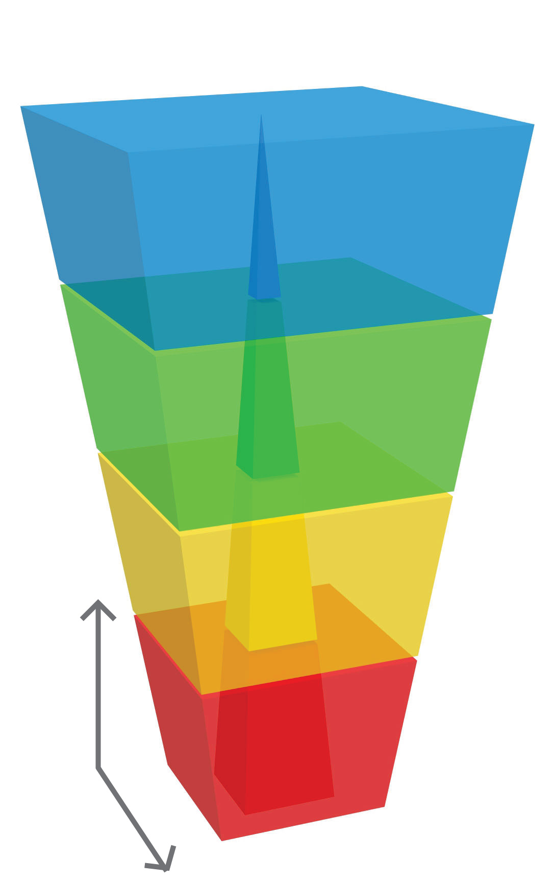
Smarter Cameras Dramatically Expand the Machine Vision Envelope
Applications accessible with Opteon components and methods
High Performance Vision
Applications feasible with conventional devices
Multi-Camera PC Based Vision
Smart Cameras
INCREASING PERFORMANCE
Bar Code Readers and 2D Scanners
QUANTITY OF DEPLOYMENTS

Slide 14
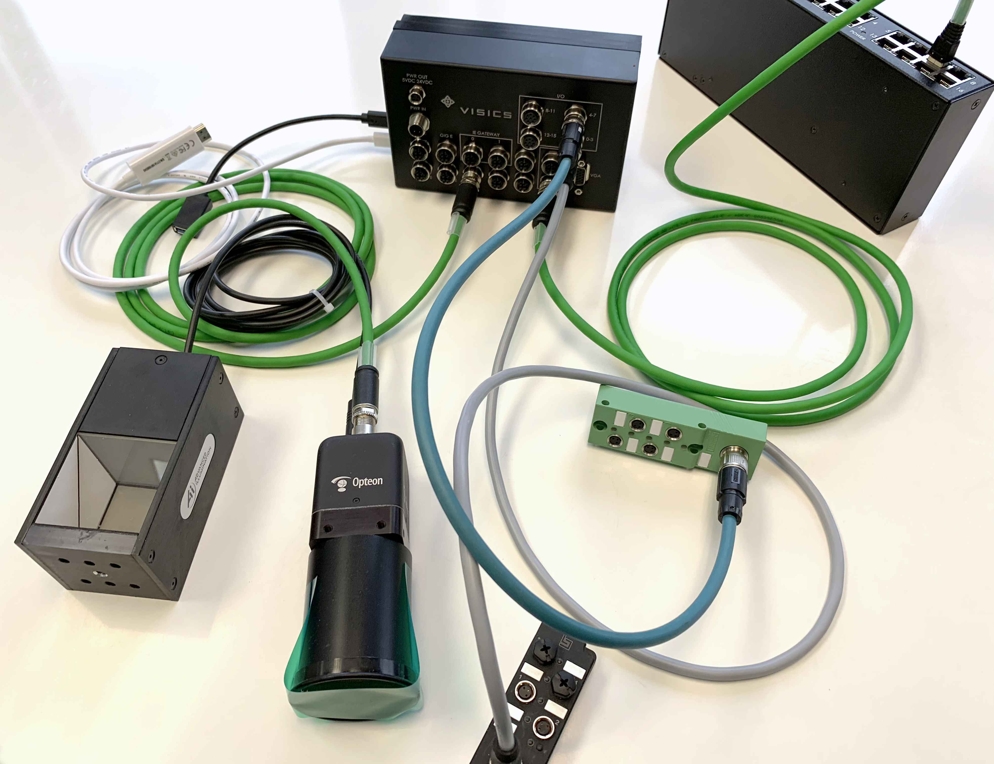
The Future
See the future, today, next door.

Slide 15
Taking the Next Step
How far can smart cameras go? Where is the new line between PC Based Vision and Smart Cameras? The answer may surprise you.
With modern methods the entire machine control electrical cabinet can go where the Smart Camera lives today. With insightful re-organization of all of the systems required to control machines and coordinate Vision decisions, such systems reduce by an order of magnitude the cabling required for machine control while greatly simplifying and accelerating development of new applications. System reliability is also greatly enhanced.
Benefits include completely deterministic machine behavior with timing coordination of 1 uS maintained throughout large machines measuring over 100 meters which incorporate multiple high speed, high resolution cameras via 10GigE and USB3. Control of such systems is now possible in a platform contained in an IP67 housing, powered via PoE, which combines Xeon class server cores, GPUs, and an embedded PLC master. Open architecture, code free deployment incorporating algorithms from multiple vendors and sources is described. Systems that deploy like Smart Cameras but pack the power of servers will become the new normal.

Slide 16
What Drove Our Thinking:
More Capable MV Systems Address More Applications
MV Applications are Highly Labor Intensive
The MV Market has progressed slower than expected
The MV Market is an Extreme Example of a complex market whose progress is gated by a large number of technologies, all of which must progress for substantial progress

Slide 17
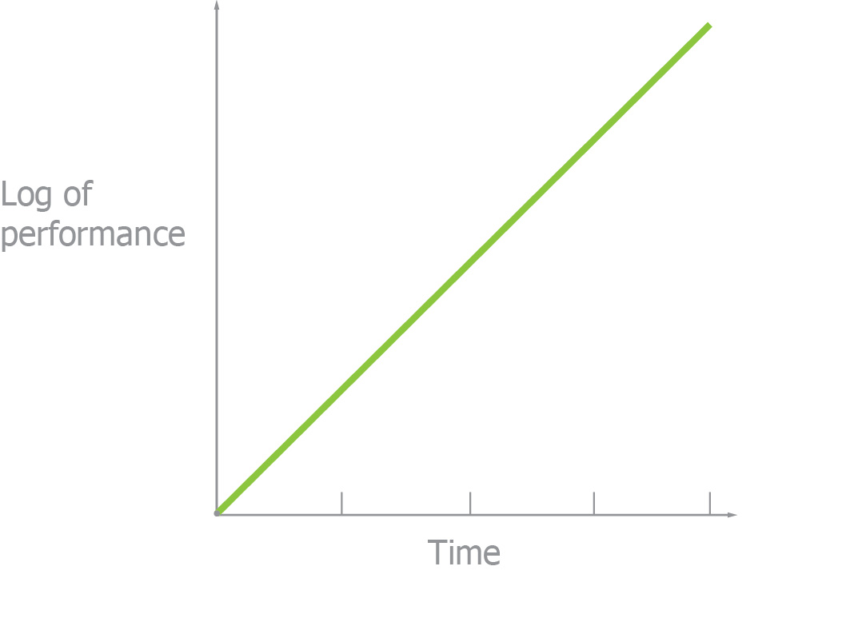
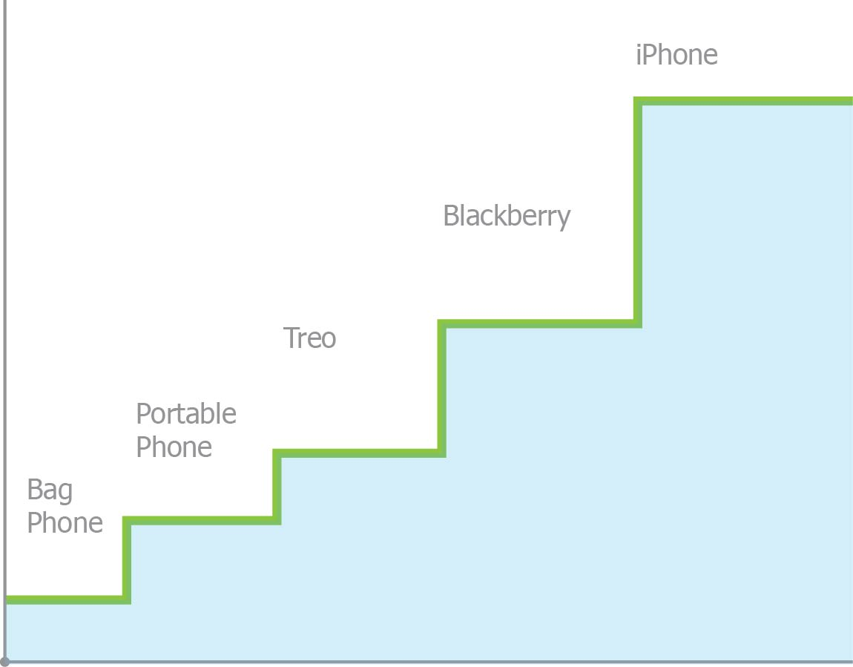
The Machine Vision Market has Progressed Slower than Expected
Industries whose progress requires advancements in multiple independent capabilities change rarely, but suddenly…
Capability and performance increase and costs fall in all industries over time
When steady improvements one key attribute are possible and sufficient to drive the economics of an industry, progress is smooth as shown by the effect of continuous reduction in transistor size for digital electronics.
Industries progress in a stepwise manner when simultaneous advances of multiple enabling technologies are necessary to substantially change their scope and economics. Rapid transformations occur in these markets when changes in multiple enabling technologies are all present creating Critical Thresholds of Elegance.
Progress of cellular phones to smart phones depended on advancements in several orthogonal areas: Batteries, Analog Power Semiconductors, Network Standards, Software, and Capital Investment in Infrastructure.
Semiconductors, Moore’s Law
Critical Thresholds of Elegance

Slide 18
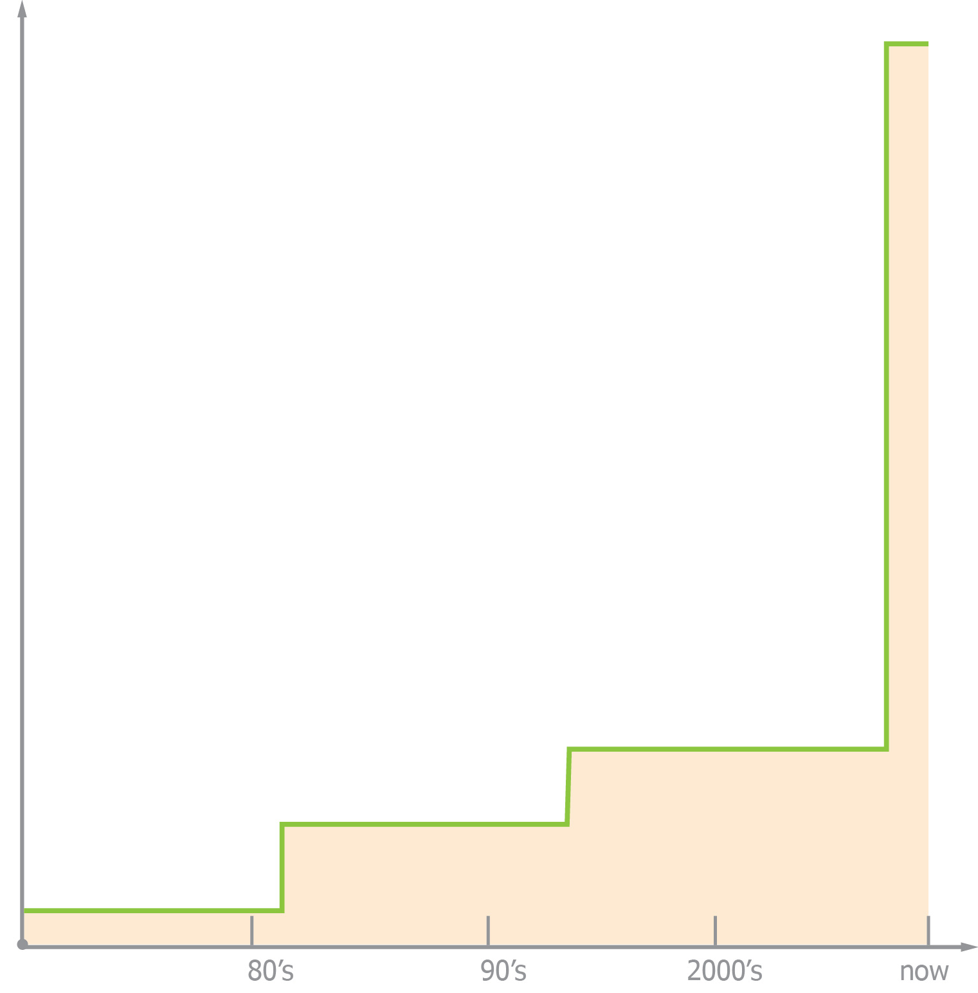
The Machine Vision Market is an Extreme Example
Progress of the Machine Vision Industry has been stalled for a very long time since progress was required in several essential enabling technologies.
Networking
Embedded Computers
Rugged deployable outside electrical-cabinets
Powerful POE in/out
Internal/Switch DMA Engines
Internal EHS PLC
Wiring Reduction
Power
Images
Trigger
Communication
Strobe
Lighting
LED
Remote
In-Camera
Machine I/O & Control
System Design
(incl. comm)
Natural/Alg Design
(Engonomic)
Diagnosis /Monitoring
Automated Deployment & Repair
Progress
Decades
Notes:
Comments: If Smart Cameras could solve challenging vision applications the vision industry would be far larger than it currently is. While congratulations are in order for how far the MV industry has progressed, some humility is in order as we contemplate that the majority of applications remain un-realized, unshipped. Every glass is half-full.

